Slide 1
Automated Car-Parking
by Giacomo Fantazzini and Claudia Badalamenti

Slide 2
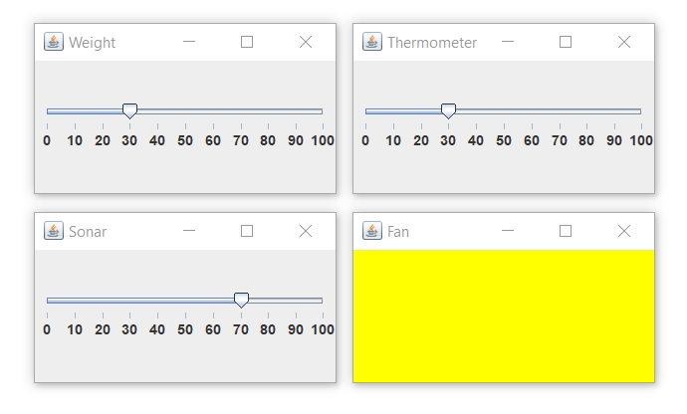
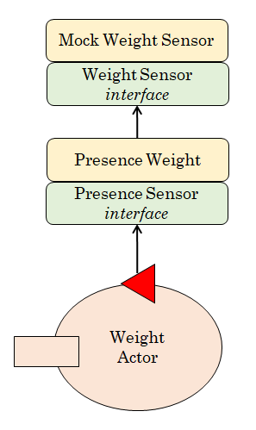
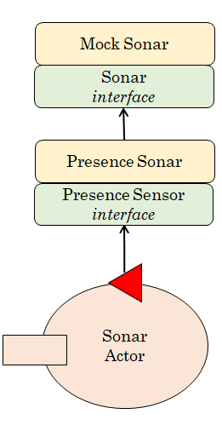
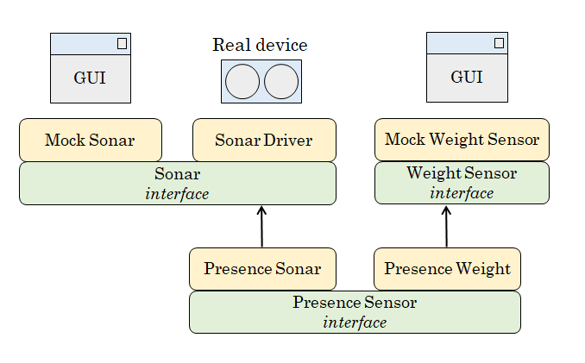
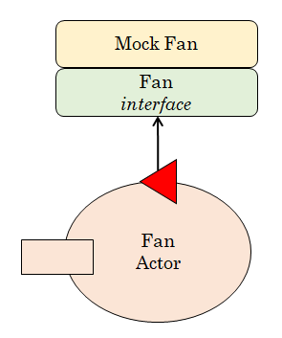
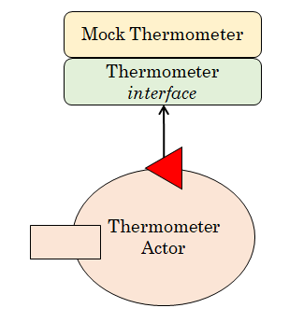
The Mock-Objects

Slide 3
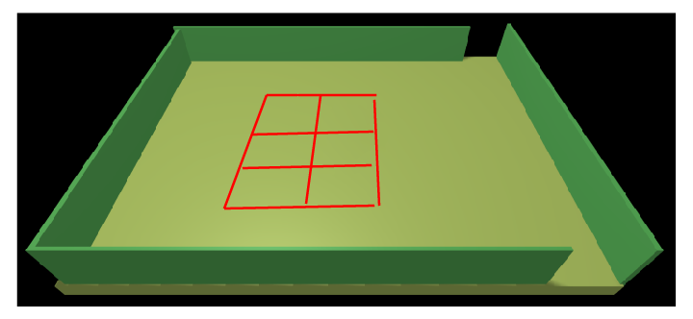
The Directional Planner
H
I
1
4
2
5
Planner Util
3
6
O
locationsKb.pl
Directional Planner
home(0, 0, s).
indoor(6, 0, n).
outdoor(6, 4, s).
parking1(1, 1, e).
parking2(1, 2, e).
parking3(1, 3, e).
parking4(4, 1, w).
parking5(4, 2, w).
parking6(4, 3, w).
step( 335 )
Park Manager Service
(business logic)
goto( PLACE )
Trolley
Actor
Basic
Robot
movementDone
cmd( l )
cmd( r )

Slide 4
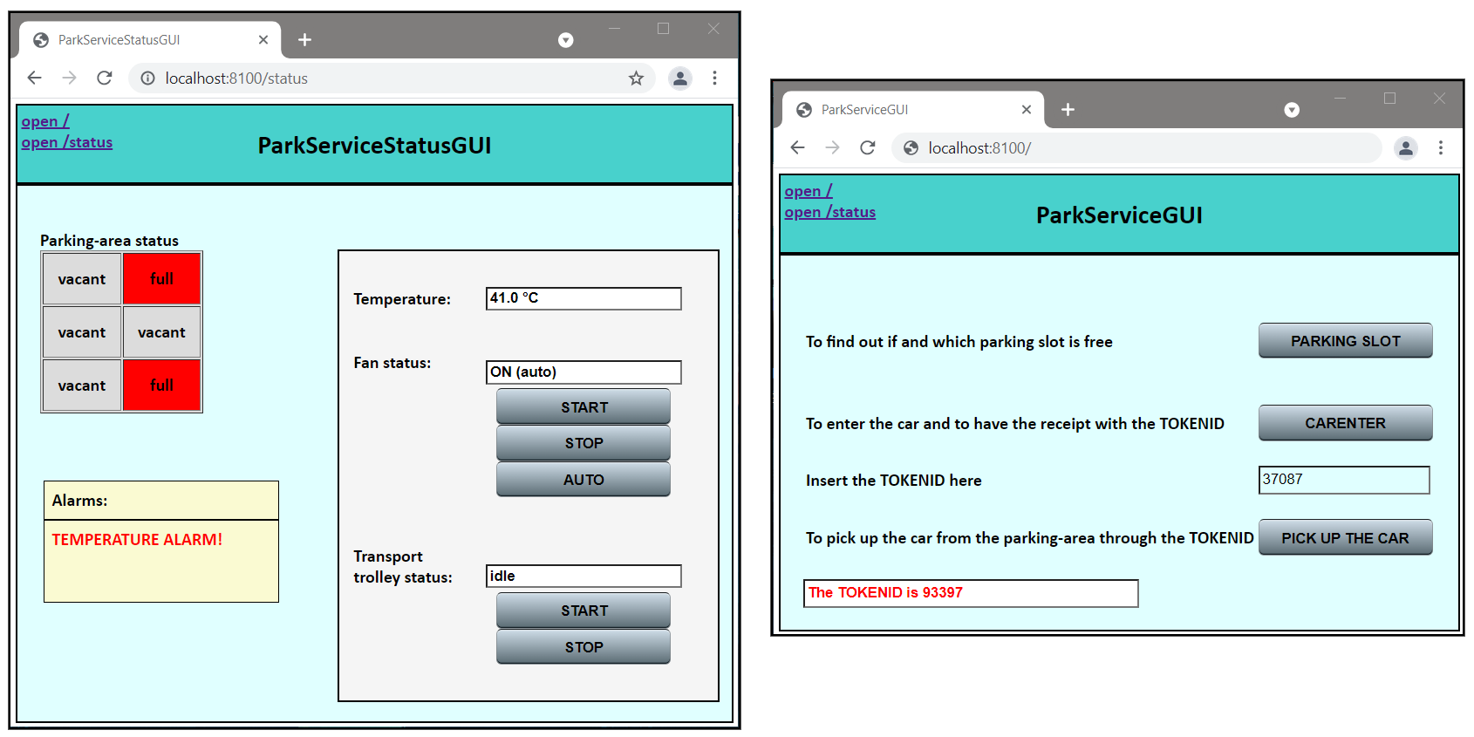
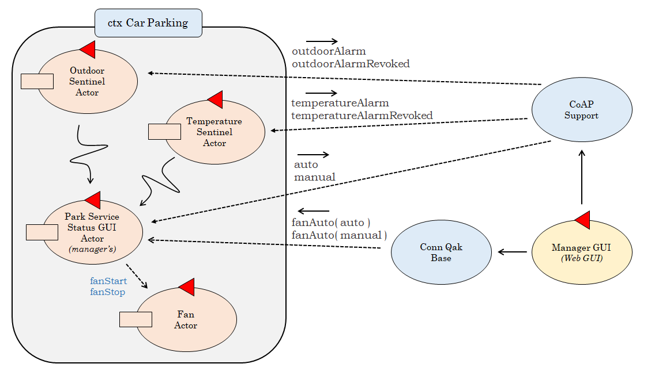
The Web GUIs

Slide 5
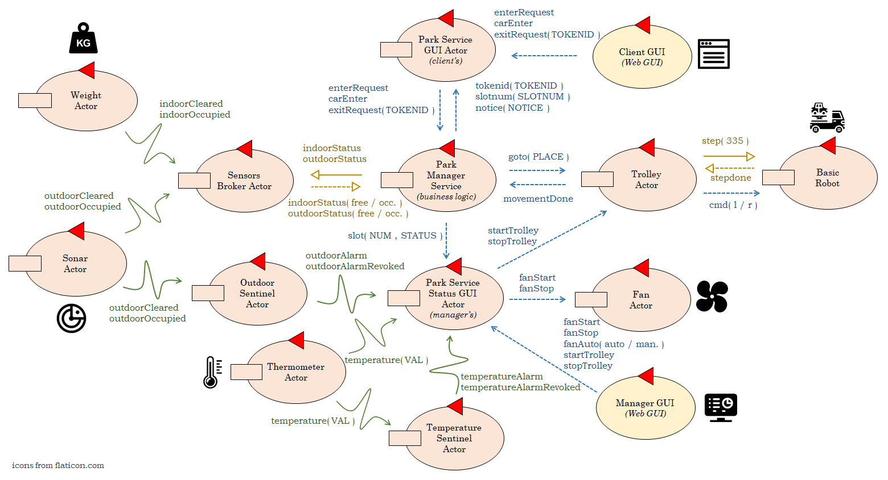
The Architecture of the System

